Slide 1
FACE MASK RECOGANISATION
TEAM MEMBERS :
BALASURYA M
AJAY N
RAAGAVENDIRAN M
NAVEEN KUMAR JB
COLLEGE NAME:
BANNARI AMMAN INSTITUTE OF TECHNOLOGY

Slide 2

INTODUCTION:
The worldwide number of new Covid cases had effectively surpassed 60 million furthermore.
the quantity of passings 1,410,378 as per data from the World Health Organization (WHO).
To restrict the spread of the illness, obligatory face-veil rules are presently getting normal in public settings all throughout the planet.
Furthermore, numerous public specialist organizations require
clients to wear face-veils as per predefined rules .
These improvements motivated investigation into programmed
(PC vision-based) procedures for face-veil recognition.
In this investigation, we return to these normal presumptions and investigate the accompanying examination questions.

Slide 3
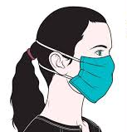
PROBLEMS:
The coronavirus disease 2019 (COVID-19) is profoundly affecting life around the globe.
Isolation, contact restrictions and economic shutdown impose a complete change to the psychosocial environment.
These measures have the potential to threaten the mental health
of children and adolescents significantly..
Anxiety, lack of peer contact and reduced opportunities for
stress regulation are main concerns.
Another main threat is an increased risk for parental mental illness, domestic violence and child maltreatment.
Such as disabilities, trauma experiences, already existing mental health problems, migrant background and low socioeconomic status, this may be a particularly challenging time.

Slide 4
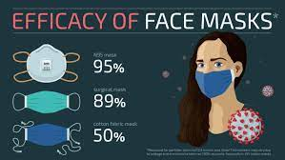
OBJECTIVE:
The predominant aim of the mission is to put into effect this gadget at airports, hospitals, and places of work wherein probabilities of spread of COVID-19 thorugh contagion are notably better.
Face information of college students, travelers, employees and people can be captured within the system at the entrance.
If everyone is determined to be without a face masks, their photo can be despatched to the government so we can take brief motion and the character will get hold of a notification to wear a masks.
The Face Mask Detection System may even screen employees with
out masks and will send them a reminder to put on one.

Slide 5
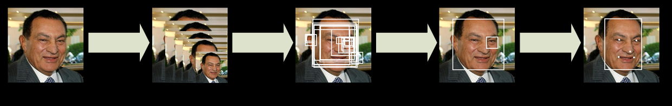
Working
First Stage—Face Detection
Face detection has made significant progress over the last decade mainly due to advances in deep-learning and convolutional neural networks.
Multi-Task Cascaded Convolutional Neural Network (MTCNN) represents a carefully designed cascaded CNN-based framework for joint face detection and alignment.
The model were selected for our experiments because of their competitive detection performance and the fact that pertained models are publicly available.

Slide 6
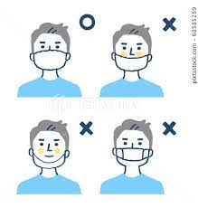
Working
Second Stage—Face Classification
To determine whether face-masks are worn correctly or not we classified into two classes
For the first class we consider faces, where the mask is placed properly and covers the nose, mouth and chin.
For the second class, we consider faces that do not have masks at all or have incorrectly placed masks

Slide 7
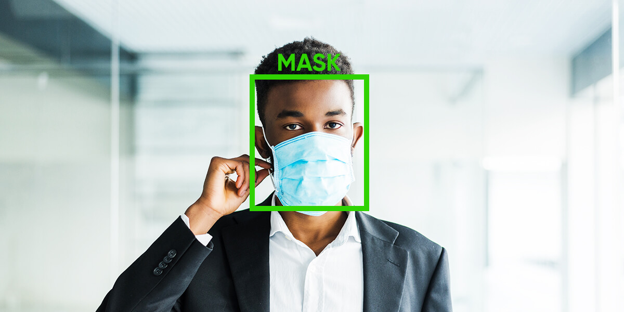
USE CASE
The Face Mask Detection System can be used at office premises to detect if employees are maintaining safety standards at work.
It monitors employees without masks and sends them a reminder to wear a mask.
The reports can be downloaded or sent an email at the end of the day to capture people who are not complying with the regulations or the requirements.
It is mainly used in hospitals to safe guard the healthy staffs and doctors.

Slide 8
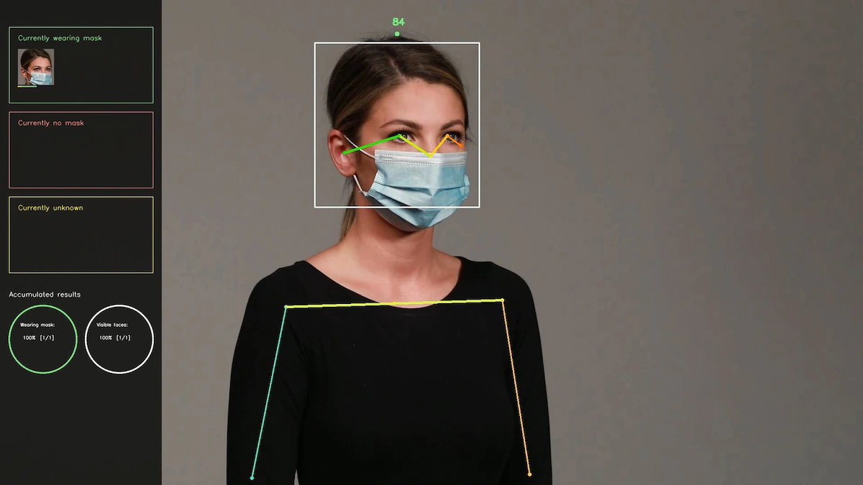
CONCLUSION
In this presentation, we studied the problem of face-mask detection relevant in the scope of monitoring applications for the COVID-19 pandemic.
We introduced a novel dataset for studying face-mask detection problems and conducted an experimental study
The performance of existing face detectors with masked-face images
The feasibility of recognition techniques aiming at the detection of properly worn face-masks
The usefulness of existing face-mask detection models for monitoring applications in the fight against COVID-19.

